Slide 1










BEBA PAY
Tokenised waste Recycling rewards

Slide 2
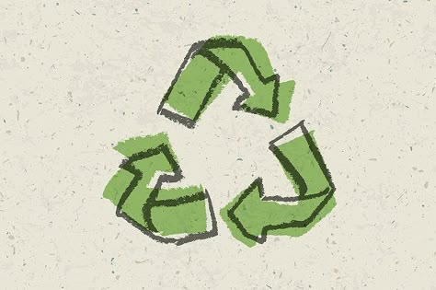
problem statement
Nairobi generates over 2,400 tonnes of waste daily, yet only about 20% of plastic is recycled, leaving the rest to clog drains, pollute rivers, and harm public health. Informal waste pickers, who recover most recyclables, earn meager income with no formal recognition. The lack of incentives and infrastructure discourages responsible disposal. As plastic production rises, this urban waste crisis worsens daily. Without urgent intervention, Nairobi risks severe environmental and economic consequences.

Slide 3
Solution
BebaPay is a Web3 app that rewards citizens for recycling plastic bottles.
Users scan barcodes on bottles using the BebaPay app.
AI verifies the barcode and triggers the creation of a digital wallet, issuing BebaPay tokens via smart contracts.
Tokens can be redeemed instantly for M-Pesa cash, airtime, or bill payments.
The system leverages existing barcode technology, making it simple and accessible to all.
It incentivizes proper waste disposal while generating extra income.
BebaPay turns trash into treasure — for people and the planet.

Slide 4





Slide 5
Value Proposition
1. Unique Selling Points (USPs)
Barcode-Based Recycling: No need for special tech or packaging — uses everyday supermarket barcodes.
AI-Triggered Wallet Creation: Instantly creates a wallet and token reward without manual registration.
Web3 Integration with M-Pesa: Combines the transparency of blockchain with Kenya’s most trusted mobile money platform.
2. Customer Benefits
Instant Rewards: Turn waste into airtime or cash with a simple scan and drop.
No Tech Hassles: Works with phones, no need for new hardware or training.
Income from Trash: Offers extra income, especially valuable in low-income communities.
3. Competitive Advantage
Low-Cost, Scalable Model: Requires minimal infrastructure, making it easier to roll out in informal settlements and urban centers.
Locally Tailored: Taps into Kenya's digital habits — barcodes, M-Pesa, and mobile-first.
Social + Environmental Impact: Appeals to NGOs and city councils tackling both waste and unemployment.

Slide 6

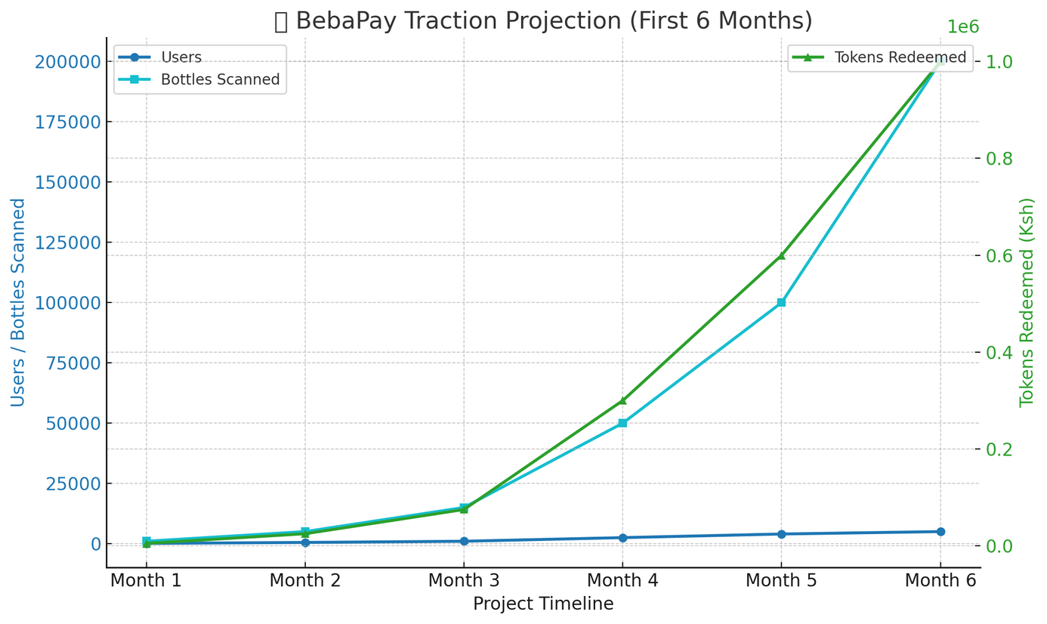
Traction
Here's a sample graph showing BebaPay’s projected traction over a 6-months pilot — including plastic collected, active users, blockchain transactions, and tokens redeemed
It visualizes how traction builds month-by-month leading up to break-even.

Slide 7
Business Model
1. Revenue Streams
BebaPay earns from transaction fees on token redemptions, brand sponsorships from eco-conscious companies, data monetization (on recycling trends), and partnerships with government or NGOs supporting sustainability.
2. Pricing Strategy
The app is free for users. Revenue is generated through small service fees charged per token redemption and premium listing options for partner recycling centers or corporate sponsors.
3. Sales & Distribution Channels
BebaPay is distributed via mobile app stores, promoted through community clean-up events, recycling center partnerships, social media campaigns, and collaborations with local influencers and environmental advocates.

Slide 8




SDG 11
BebaPay contributes to reducing urban waste and improving city cleanliness by encouraging responsible waste disposal and recycling in Nairobi.
SDG 13
Helps mitigate climate change by reducing the amount of plastic burned or dumped in landfills, which releases harmful emissions.

Slide 9
Team
Risper Joy
Mitau Nyamai
Johnson Kamau
Keziah Mwanga

Slide 10
Q&A

Slide 11
Thank you!

